Slide 1


Holiday Package Prediction
Ankur Bhargava

Slide 2
Agenda
Introduction
Objective
Training Model
Model summary
Summary
Conclusion
Data Analysis
Analyzing Feature and target
Result and Tuning
Inference
References

Slide 3
Objective
"Travel.Com" company wants to enable and establish a viable business model to expand the customer base. One of the ways to expand the customer base is to introduce a new offering of packages. Currently, there are 5 types of packages the company is offering - Basic, Standard, Deluxe, Super Deluxe, King. Looking at the data of the last year, we observed that 18% of the customers purchased the packages. However, the marketing cost was quite high because customers were contacted at random without looking at the available information. The company is now planning to launch a new product i.e. Wellness Tourism Package. Wellness Tourism is defined as Travel that allows the traveler to maintain, enhance or kick-start a healthy lifestyle, and support or increase one's sense of well-being. However, this time company wants to harness the available data of existing and potential customers to make the marketing expenditure more efficient.
We need to analyze the customers' data and information to provide recommendations to the Policy Maker and Marketing Team and also build a model to predict the potential customer who is going to purchase the newly introduced travel package.

Slide 4
About the Data
What's inside is more than just rows and columns. Make it easy for others to get started by describing how you acquired the data and what time period it represents, too.
Most important features that have an impact on Product taken: Designation, Passport, Tier City, Martial status, occupation
Customers with Designation as Executive should be the target customers for the company .Customers who have passport and are from tier 3 city and are single or unmarried, have large business such customers have higher chances of taking new package.
Customers monthly income in range of 15000- 25000, and age range 15-30, prefer 5 star properties also have higher chances of taking new package based on EDA.

Slide 5
Approach to solve the problem
We need to analyze the customers' data and information to provide recommendations to the Policy Maker and Marketing Team and also build a model to predict the potential customer who is going to purchase the newly introduced travel package.

Slide 6
Understanding Data
We have copied the data to data frame using pandas library and trying to understand the data. In total there are 4888 entities and 20 columns as listed below
CustomerID
ProdTaken
Age
TypeofContact
CityTier
DurationOfPitch
Occupation
Gender
NumberOfPersonVisiting
NumberOfFollowups
ProductPitched
PreferredPropertyStar
MaritalStatus
NumberOfTrips
Passport
PitchSatisfactionScore
OwnCar
NumberOfChildrenVisiting
Designation
MonthlyIncome

Slide 7
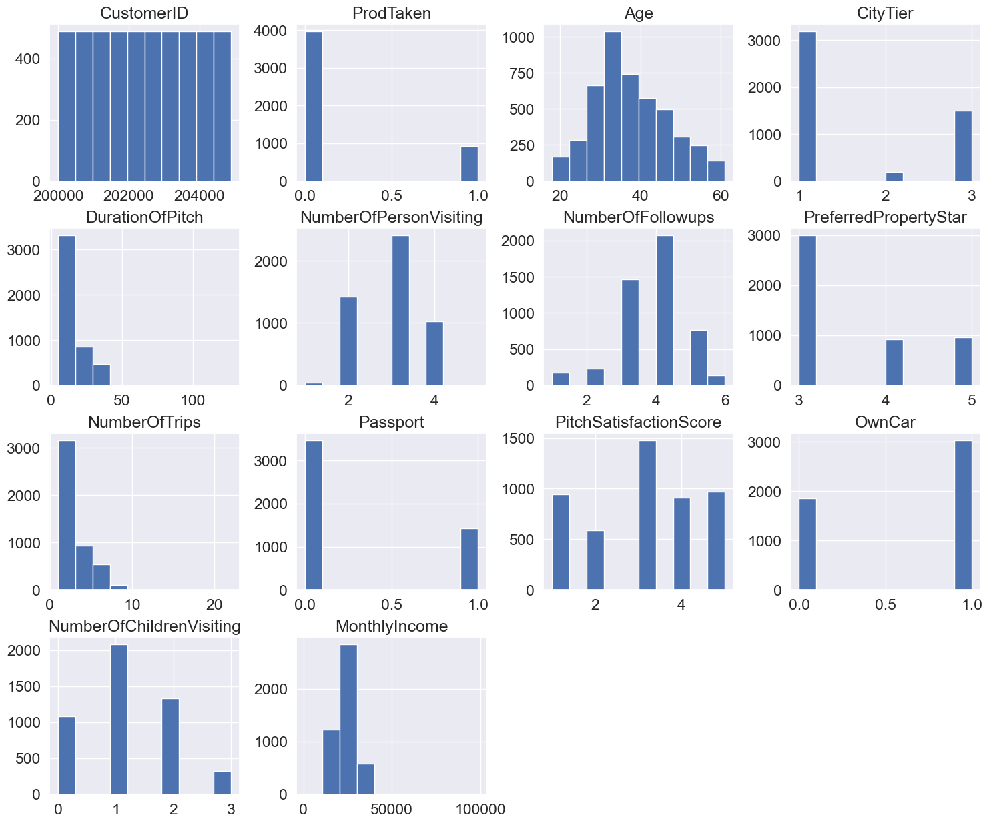
Visualizing the data

Slide 8
Understanding categorical and numeric data
Data columns can split into categorical data or numeric data as below.
cats = ['ProdTaken', 'CityTier', 'PreferredPropertyStar', 'Passport’, 'OwnCar', 'PitchSatisfactionScore', 'TypeofContact', 'Occupation', 'Gender', 'ProductPitched’, 'MaritalStatus', 'Designation']
nums = ['CustomerID', 'Age', 'DurationOfPitch','NumberOfPersonVisiting', 'NumberOfFollowups','NumberOfTrips', 'NumberOfChildrenVisiting', 'MonthlyIncome']

Slide 9
Categorical data
ProdTaken: [1 0]
CityTier: [3 1 2]
PreferredPropertyStar: [ 3. 4. 5. nan]
Passport: [1 0]
OwnCar: [1 0]
PitchSatisfactionScore: [2 3 5 4 1]
TypeofContact: ['Self Enquiry' 'Company Invited' nan]
Occupation: ['Salaried' 'Free Lancer' 'Small Business' 'Large Business']
Gender: ['Female' 'Male' 'Fe Male']
ProductPitched: ['Deluxe' 'Basic' 'Standard' 'Super Deluxe' 'King']
MaritalStatus: ['Single' 'Divorced' 'Married' 'Unmarried']
Designation: ['Manager' 'Executive' 'Senior Manager' 'AVP' 'VP']
In Categorial field we observe some data inconsistence , so we have to fix them
Gender: ['Female' 'Male' 'Fe Male']
MaritalStatus: ['Single' 'Divorced' 'Married' 'Unmarried']

Slide 10
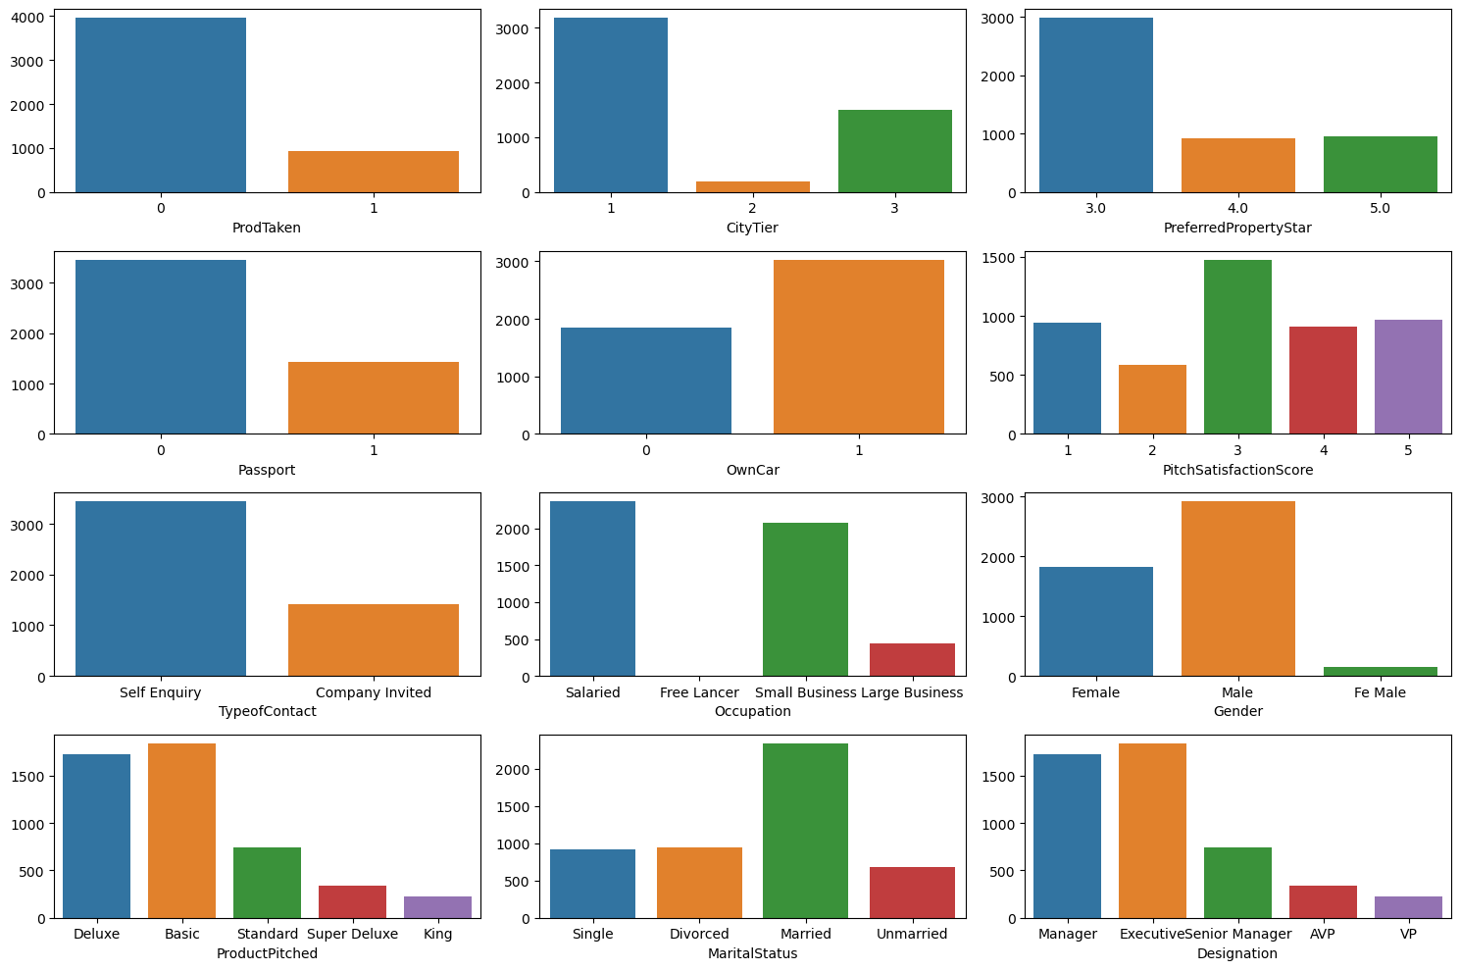
Categorical data Continue

Slide 11
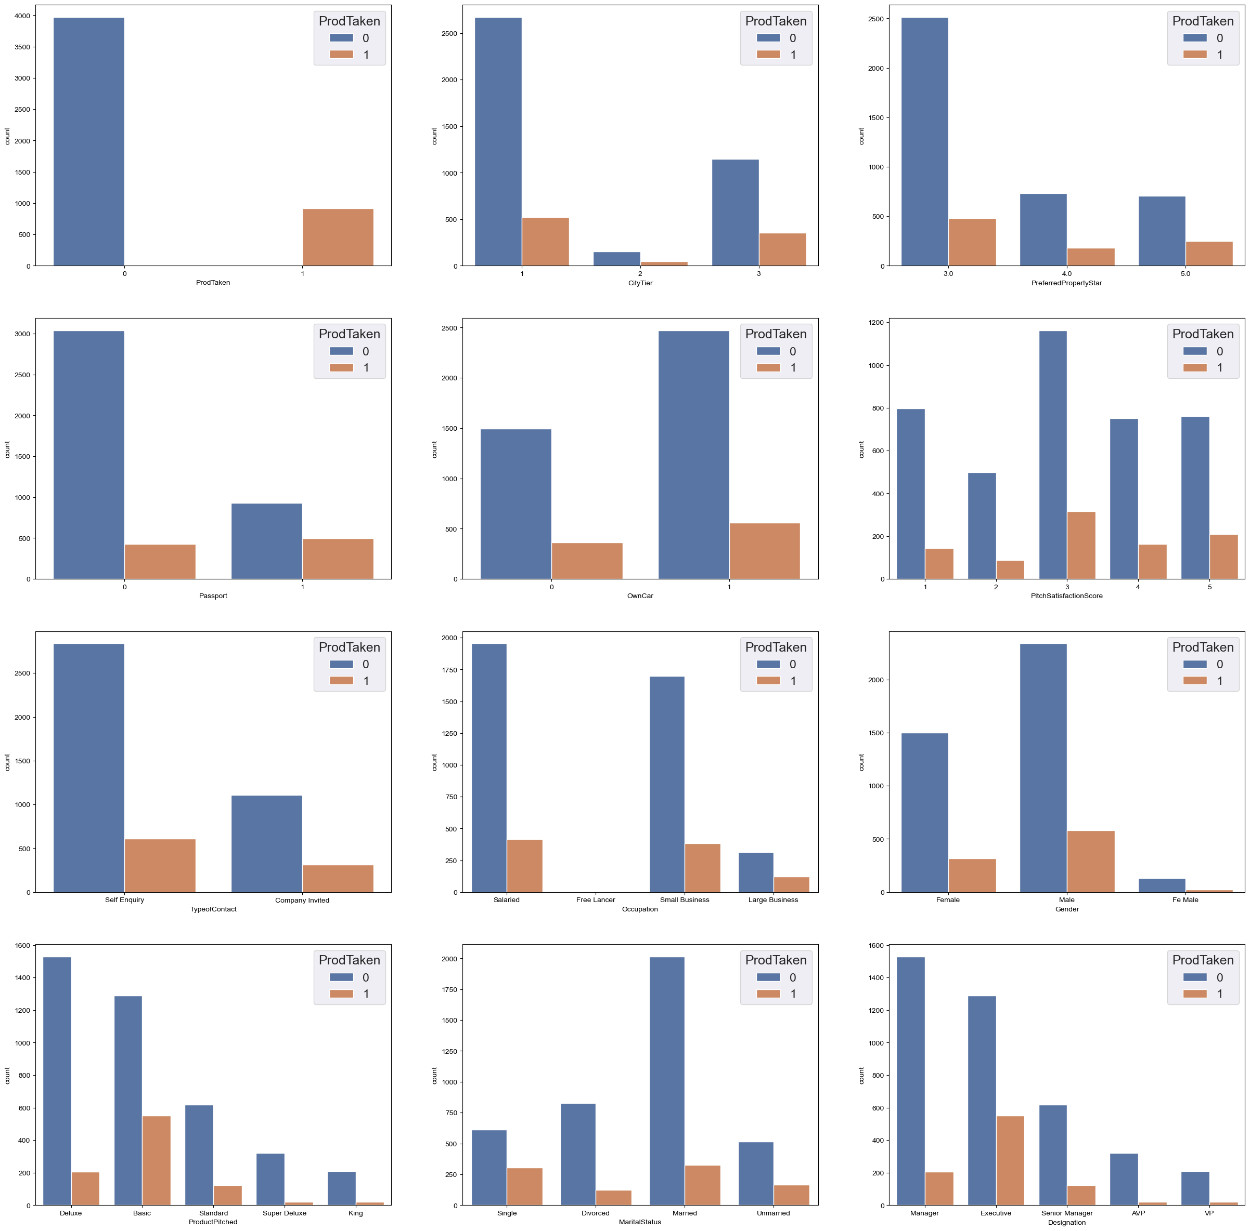
Categorical data Continue

Slide 12
Numeric data
Age 4.62357 % missing values
TypeofContact 0.51146 % missing values
DurationOfPitch 5.13502 % missing values
NumberOfFollowups 0.92062 % missing values
PreferredPropertyStar 0.53191 % missing values
NumberOfTrips 2.86416 % missing values
NumberOfChildrenVisiting 1.35025 % missing values
MonthlyIncome 4.76678 % missing values

Slide 13
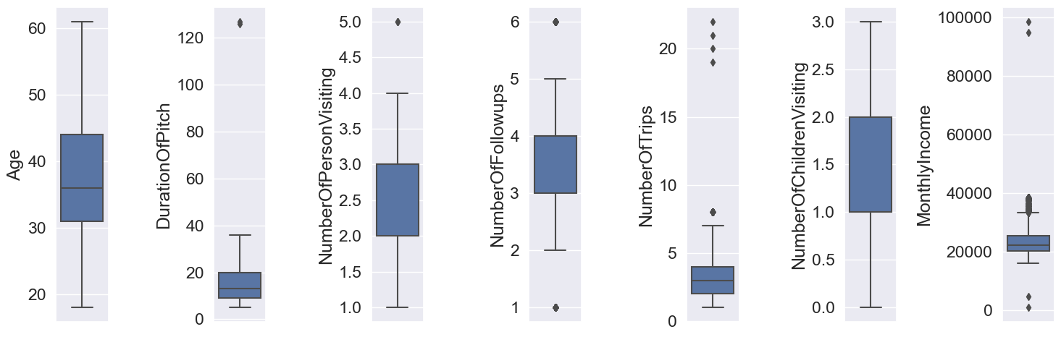
Numeric data ~ Distribution

Slide 14
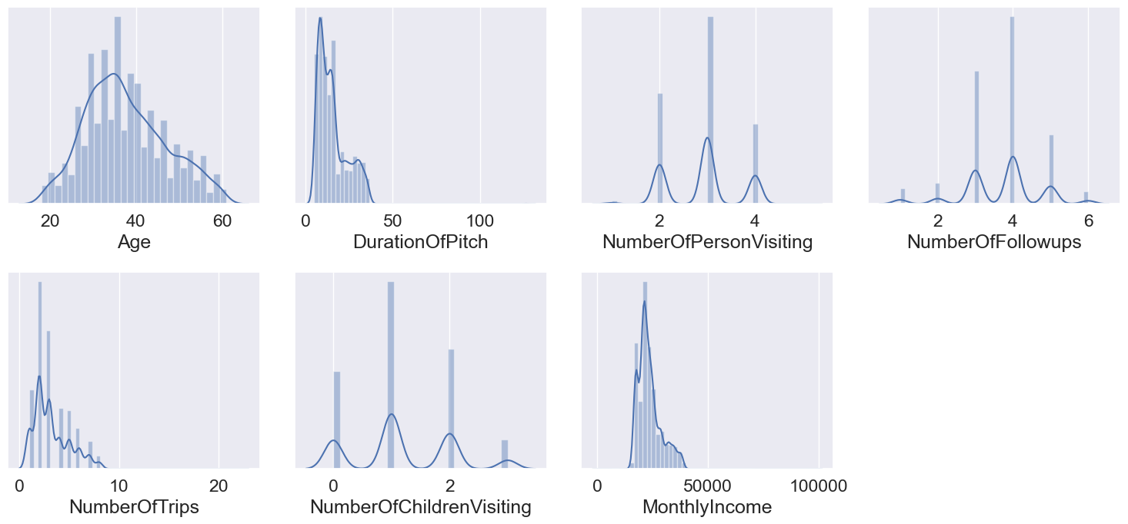
Numerical data Continue

Slide 15
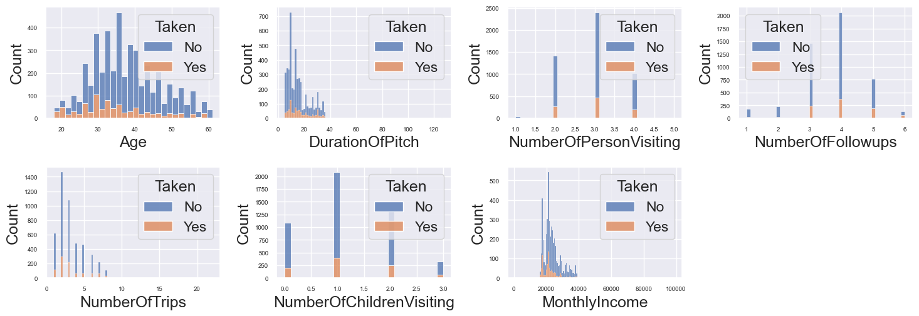
Numeric data ~ for Product taken /not taken

Slide 16
Imputing Numeric data
#Age
df.Age.fillna(df.Age.median(), inplace=True)
#Type of Contact
df.TypeofContact.fillna(df.TypeofContact.mode()[0], inplace=True)
#DurationOfPitch
df.DurationOfPitch.fillna(df.DurationOfPitch.median(), inplace=True)
#NumberOfFollowups
df.NumberOfFollowups.fillna(df.NumberOfFollowups.mode()[0], inplace=True)
#PreferredPropertyStar
df.PreferredPropertyStar.fillna(df.PreferredPropertyStar.mode()[0], inplace=True)
#NumberOfTrips
df.NumberOfTrips.fillna(df.NumberOfTrips.median(), inplace=True)
#NumberOfChildrenVisiting
df.NumberOfChildrenVisiting.fillna(df.NumberOfChildrenVisiting.mode()[0], inplace=True)
#MonthlyIncome
df.MonthlyIncome.fillna(df.MonthlyIncome.median(), inplace=True)

Slide 17
Data changes and summary
df.drop('CustomerID', inplace=True, axis=1)
# We will create a new column TotalVisiting that will be addition of two columns i.e. NumberOfPersonVisiting and NumberOfChildrenVisiting
df['TotalVisiting'] = df['NumberOfPersonVisiting'] + df['NumberOfChildrenVisiting']
df.drop(columns=['NumberOfPersonVisiting', 'NumberOfChildrenVisiting'], axis=1, inplace=True)
Number of Numerical Features are: 12
Number of Categorical Features are: 6
Number of Discrete Features are: 9
Number of Continuous Features are: 3
Thus from above data we can say that our data include 17 feature and 1 target value (ProdTaken)

Slide 18
Training Model
Before we start with Model training , from our objective we can stay that this is a model for supervised learning and we will use classification to build our model
We have used sklearn and split our data for training and testing with 80:20 ratio
X = df.drop(columns=['ProdTaken'], axis=1)
y = df['ProdTaken’]
X_train_orig, X_test_orig, y_train_orig, y_test_orig = train_test_split(X,y,test_size=0.2,random_state=42)
X_train_orig.shape, X_test_orig.shape
((3910, 17), (978, 17))

Slide 19
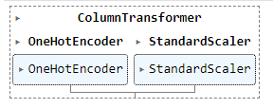
Data Preprocessing
For category data I have used One Hot encoder and for numeric data standard scaler is user.
from sklearn.preprocessing import OneHotEncoder, StandardScaler
from sklearn.compose import ColumnTransformer
numeric_transformer = StandardScaler()
oh_transformer = OneHotEncoder(drop='first')
preprocessor = ColumnTransformer(
[
("OneHotEncoder", oh_transformer, cat_features),
("StandardScaler", numeric_transformer, num_features)])

Slide 20
Model with different algorithms
We have used for below algorithm to train our model
"Logistic Regression": LogisticRegression(),
"Decision Tree": DecisionTreeClassifier(),
"Random Forest": RandomForestClassifier(),
"Bagging": BaggingClassifier(),
"SVC": svm.LinearSVC()

Slide 21
Model Performance
Logistic Regression
Decision Tree
Random Forest
Model performance for Training set:
Accuracy: 0.8458
F1 Score: 0.4230
Precision: 0.6994
Recall: 0.3032
Model performance for Testing set:
Accuracy: 0.8354
F1 Score: 0.4103
Precision: 0.6829
Recall: 0.2932
Model performance for Training set:
Accuracy: 1.0000
F1 Score: 1.0000
Precision: 1.0000
Recall: 1.0000
Model performance for Testing set:
Accuracy: 0.9110
F1 Score: 0.7668
Precision: 0.7857
Recall: 0.7487
Model performance for Training set:
Accuracy: 1.0000
F1 Score: 1.0000
Precision: 1.0000
Recall: 1.0000
Model performance for Testing set:
Accuracy: 0.9325
F1 Score: 0.7950
Precision: 0.9771
Recall: 0.6702

Slide 22
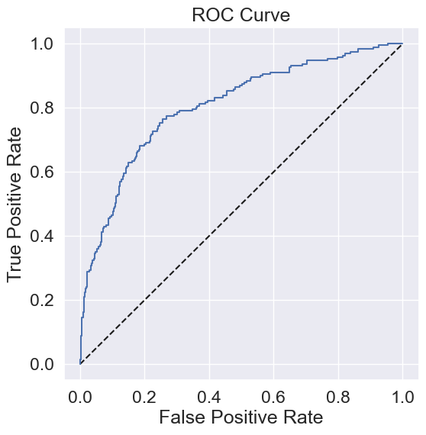
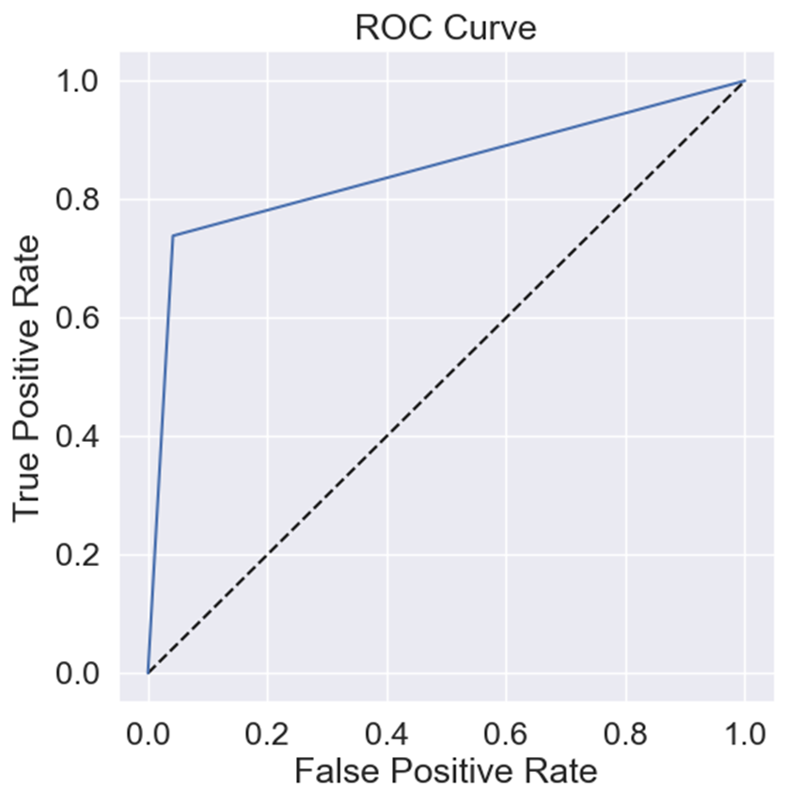
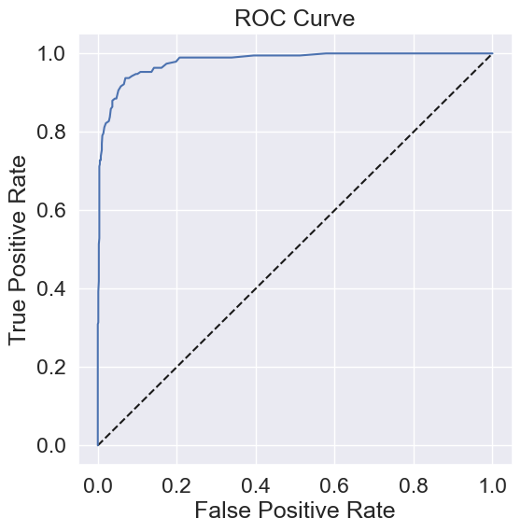
Classification report and ROC curve

Slide 23
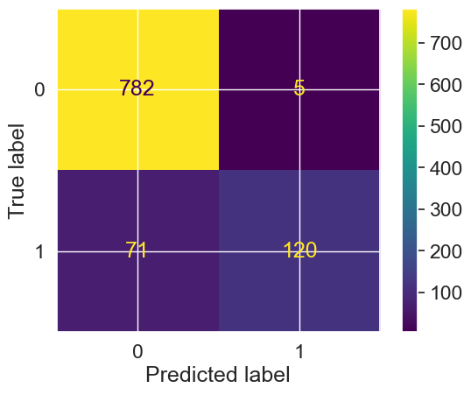
Cross Validation
As RandomForest is giving good accuracy of 93 % , I have tried Cross validation and getting a Mean AUROC of 95.26 %, which is a good matrix and conclude that best estimator for holiday package is Random Forest
rf = RandomForestClassifier()
rf.fit(X_train, y_train)
print('success’)
from sklearn.model_selection import cross_val_score, RepeatedStratifiedKFold
cv = RepeatedStratifiedKFold(n_splits=5, n_repeats=3, random_state=1)
scores = cross_val_score(rf, X_train, y_train, scoring = 'roc_auc', cv = cv)
AUROC = np.mean(scores)
# print the mean AUROC score
print('Mean AUROC: %.4f' % (AUROC))
from sklearn.metrics import ConfusionMatrixDisplay
y_hat_test = rf.predict(X_test)
ConfusionMatrixDisplay.from_predictions(y_test, y_hat_test)

Slide 24
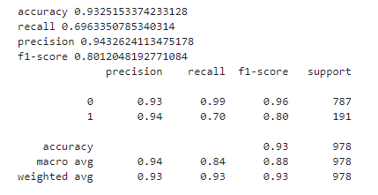
Hyper tuning of model param
From above model selection we can concluded that Random Forest classifier provide us better performance matrix then other algorithms.
rf_params = {
"max_depth": [5,8,15,None, 10],
"max_features": [5,7,"auto",8],
"min_samples_split": [2,8,15,20],
"n_estimators": [100,200,500,1000]
}
randomcv_models = [
("RF", RandomForestClassifier(), rf_params)
]
from sklearn.model_selection import RandomizedSearchCV
model_param = {}
for name, model, params in randomcv_models:
random = RandomizedSearchCV(estimator=model,
param_distributions=params,
n_iter=100,
cv=3,
verbose=2,
n_jobs=-1)
random.fit(X_train, y_train)
model_param[name] = random.best_params_
for model_name in model_param:
print(f"----------Best Params for {model_name}-----------")
print(model_param[model_name])

Slide 25
Conclusion
Best Estimator : Random Forest Classifier
Final accuracy on test set : 93% and cross validation give us a mean AUROC of 95%
When we tried hyper tuning Random forest params we didn’t receive any performance benefit.
In future we can also try to validate the data set on other estimator like Gradient Boosting and Adaboost

Slide 26
Reference
Data set : https://www.kaggle.com/datasets/susant4learning/holiday-package-purchase-prediction
Source code : https://github.com/ankurbhargava0511/HolidayPrediction

Slide 27
Updating with NN
import tensorflow as tf
tf.random.set_seed(42)
model = tf.keras.Sequential([
tf.keras.layers.Dense(128, activation='relu'),
tf.keras.layers.Dense(256, activation='relu'),
tf.keras.layers.Dense(256, activation='relu'),
tf.keras.layers.Dense(1, activation='sigmoid')
])
model.compile(
loss=tf.keras.losses.binary_crossentropy,
optimizer=tf.keras.optimizers.Adam(lr=0.03),
metrics=[
tf.keras.metrics.BinaryAccuracy(name='accuracy'),
tf.keras.metrics.Precision(name='precision'),
tf.keras.metrics.Recall(name='recall')
]
)
history = model.fit(X_train, y_train, epochs=100)

Slide 28
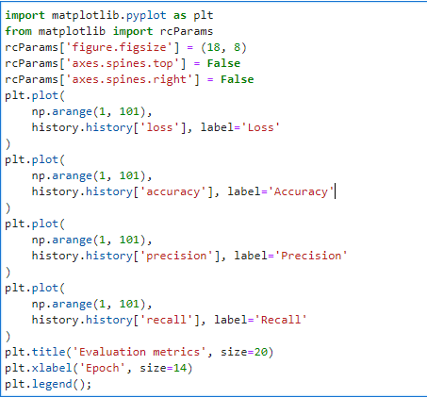
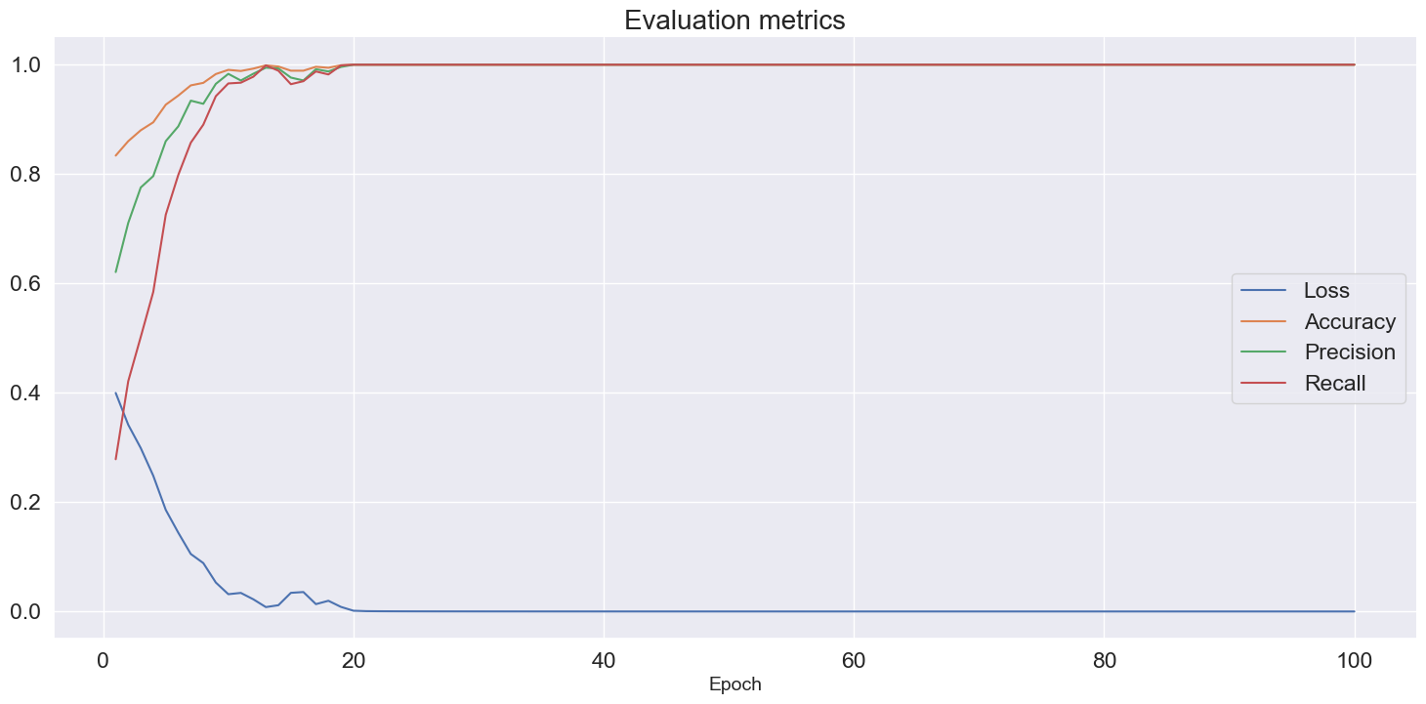
NN Evaluation

Slide 29
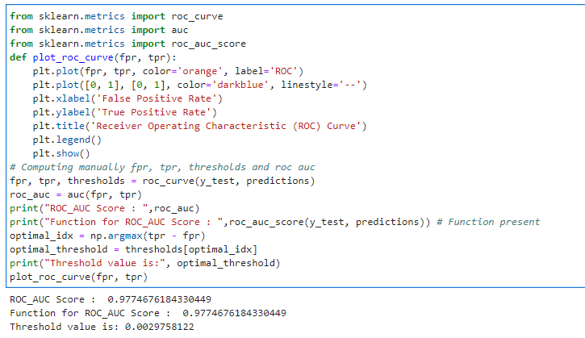
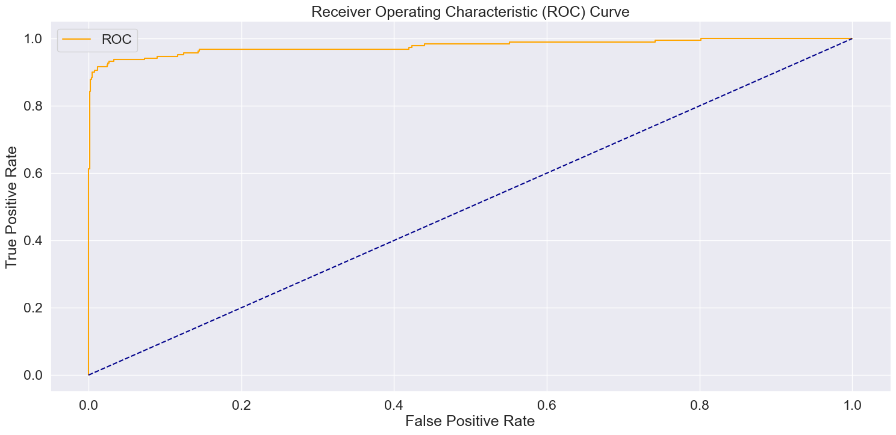
NN- ROC Curve

Slide 30
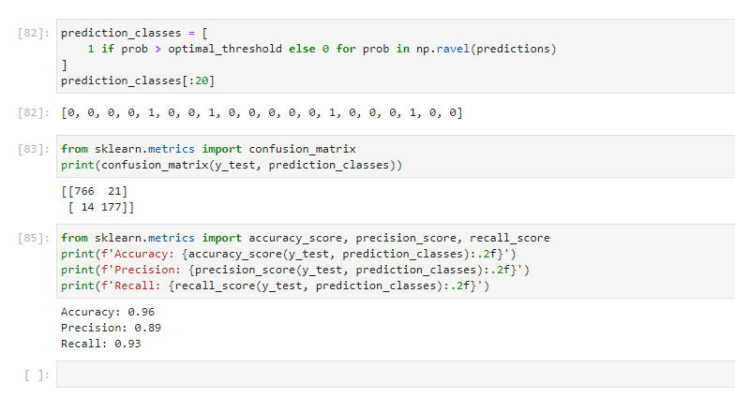
NN Conclusion
With Basic Neural Network having 4 layer we can achieve the accuracy up to .96 which is good and better the any machine learning model

